Slide 1
Abnormal Crowd Behavior Detection
Supervised by: Eng.Heba Mahgoub and Dr.Ghada Soliman

Slide 2
Team members
Ibrahim Yassen
Muhammad Ahmed
Muhammad Momen
Asmaa Ali

Slide 3
Agenda
Introduction : Motivation & Objectives
Related Work & Literature Review
Datasets Used
Pipeline
Methodology & Architecture
Results
Conclusion & Future Work
Appendix

Slide 4
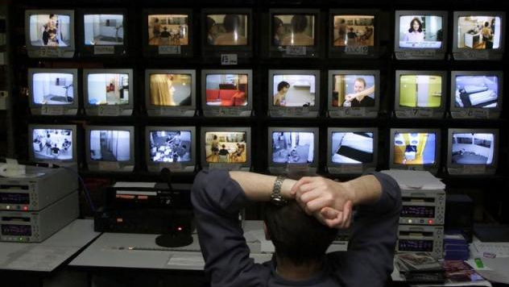
Problem & Motivation
Surveillance cameras are increasingly being used in public places e.g. streets, intersections, banks, shopping malls,etc. to increase public safety. However, the monitoring capability of law enforcement agencies has not kept pace. The result is that there is a glaring deficiency in the utilization of surveillance cameras and an unworkable ratio of cameras to human monitors.
One critical task in video surveillance is detecting anomalous events such as traffic accidents, crimes or illegal activities. Generally, anomalous events rarely occur as compared to normal activities. Therefore, to alleviate the waste of labor and time, developing intelligent computer vision algorithms for automatic video anomaly detection is a pressing need.
The goal of a practical anomaly detection system is to timely signal an activity that deviates normal patterns and identify the time window of the occurring anomaly. Therefore, anomaly detection can be considered as coarse level video understanding, which filters out anomalies from normal patterns. Once an anomaly is detected, it can further be categorized into one of the specific activities using classification techniques.

Slide 5
Challenges
The task of joint anomaly detection and classification is challenging due to :
Unavailability of large corpus of annotated data for learning a wide variety of normal and anomaly patterns.
The traits of anomaly activities such as abuse, stealing, shoplifting, shooting, and robbery differ in their temporal extent.
It is very difficult or impossible to define a normal event which takes all possible normal patterns/behaviors into account .
The boundary between normal and anomalous behaviors is often ambiguous. In addition, under realistic conditions, the same behavior could be a normal or an anomalous behavior under different conditions.
Computation complexity: Datasets are heavy, and models are resource-consuming require dedicated GPUs and computing nodes to achieve high results.
One of the great solutions to tackle this problem by using anomaly detection algorithm using weakly labeled training videos. That is we only know the video-level labels, i.e. a video is normal or contains anomaly somewhere, but we do not know where.

Slide 6
Objectives
Using Computer vision concepts & deep learning techniques to detect and recognize anomalies efficiently.
1
keep a high performance suitable for near real time processing on videos.
2
3
Localization :given a frame/image the model should extract the location of all humans

Slide 7
Related Datasets
1) Datasets for motion anomaly detection - UCSD Dataset
Datasets in this subsection are designed to present different anomalous motion patterns. These anomalies are usually defined by speeds or trajectories that deviate from expected normal motion flows in the scene. The presence of non-authorized elements is also a common trend in these datasets (e.g. vehicles or bicycles on pedestrian paths), and thus abnormal motion and appearance are usually considered together.
2) Datasets for action anomaly detection - UCF Crime
The main task of the datasets presented in this subsection is to identify when a person in the scene presents an abnormal behavior. Usually, behaviors considered as abnormal are uncivil behaviors such as stealing, fighting, snatching, etc.

Slide 8
UCSD Dataset
Two different sets of videos sequences:
Peds1: 34 training and 36 testing videos sequences.
people walk towards and away from the camera
Peds2: 16 training and 12 testing sequences.
individuals move in parallel to the camera plane
Each clip is ~ 200 frames (20 s) , 158 × 238 resolution.
Frame is considered to be anomalous if there is a non-pedestrian element in the scene (e.g. bikers, skaters, etc.) or if a pedestrian shows an abnormal motion pattern
3400 frames contain anomalies.
5500 frames are normal.

Slide 9
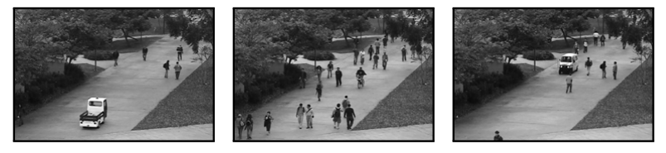
UCSD Dataset
Example of anomaly: Cars are not allowed in pedestrian path.

Slide 10
UCF-Crime Dataset
Consisting of 1900 untrimmed video sequences
Completely wild
Captured from different scenes
128 hours of video
950 of normal events and 950 of abnormal ones
13 classes:
abuse, arrest, arson, assault, road accident, burglary, explosion, fighting, robbery, shooting, stealing, shoplifting and vandalism.
Training set : 800 normal and 810 anomalous videos
Testing set : 150 normal and 140 anomalous videos

Slide 11
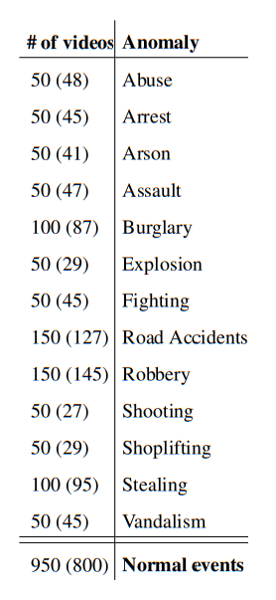
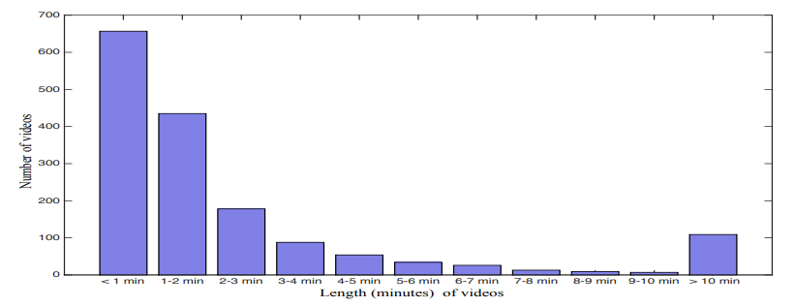
UCF-Crime Dataset
Distribution of videos according to length (minutes) in the training set.

Slide 12
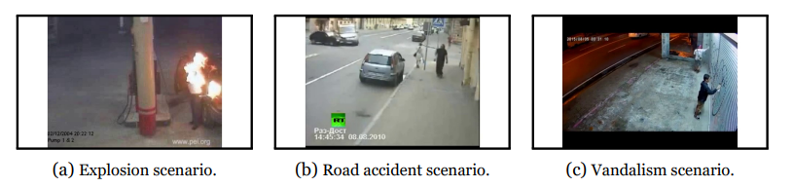
UCF-Crime Dataset
Examples of different anomalies from the training and testing videos in UCF dataset.

Slide 13
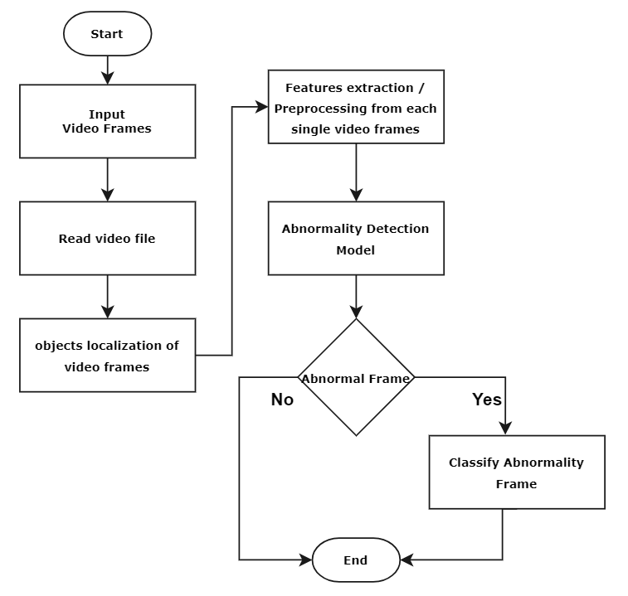
Pipeline

Slide 14
Localization

Slide 15
Localization
In this phase , we implement state of the art object detection algorithm (one and two stage detectors) :
RetinaNet (One stage detector )
Yolo V5 , Yolo V3 (One Stage detector )
Mask -RCNN ( two stage detector )

Slide 16
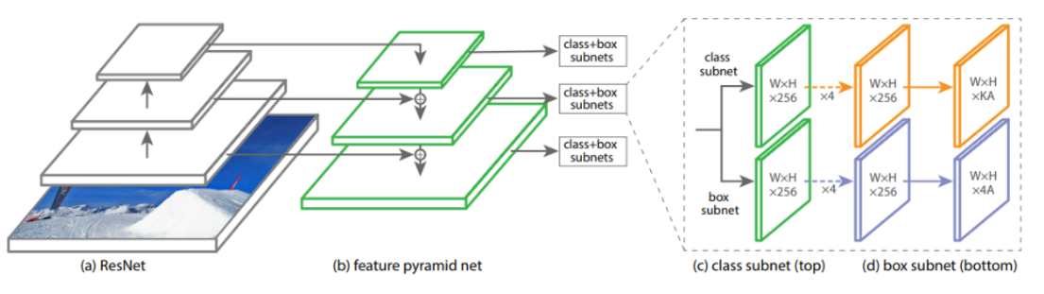
RETINANET
Focal Loss for Dense Object Detection
RetinaNet architecture

Slide 17
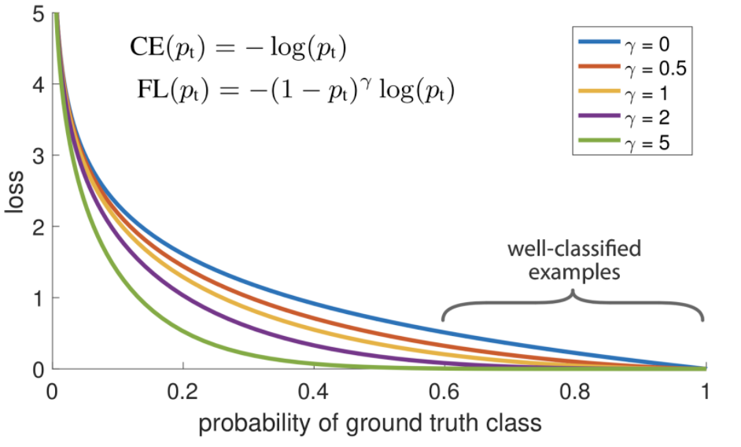
RETINANET
Focal Loss for Dense Object Detection
Focal Loss
Focal Loss (FL) is an improved version of Cross-Entropy Loss (CE) that tries to handle the class imbalance problem by assigning more weights to hard or easily misclassified examples (i.e. background with noisy texture or partial object or the object of our interest ) and to down-weight easy examples (i.e. Background objects).
So Focal Loss reduces the loss contribution from easy examples and increases the importance of correcting misclassified examples. Focal loss is just an extension of the cross-entropy loss function that would down-weight easy examples and focus training on hard negatives.

Slide 18
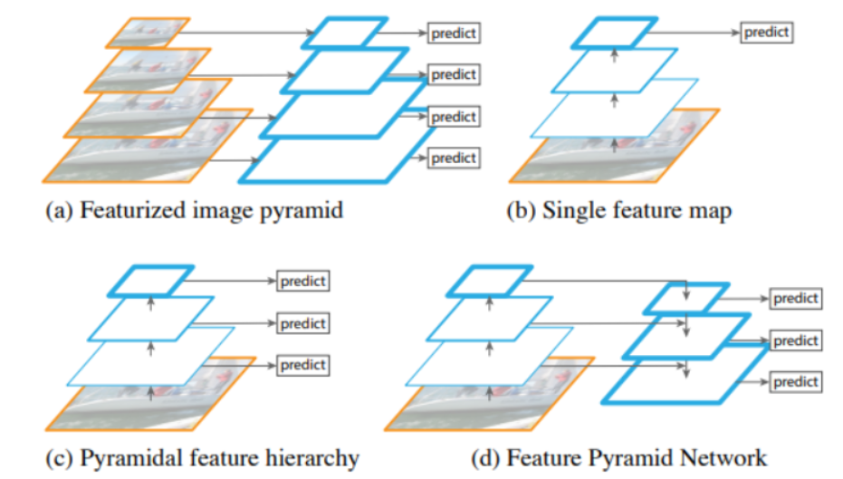
RETINANET
Focal Loss for Dense Object Detection
Feature Pyramid Network
Traditionally, in computer vision, feature image pyramids have been used to detect objects with varying scales in an image. Feature image pyramids are feature pyramids built upon image pyramids. This means one would take an image and subsample it into lower resolution and smaller size images (thus, forming a pyramid). Hand-engineered features are then extracted from each layer in the pyramid to detect the objects . This makes the pyramid scale-invariant. But, this process is compute and memory intensive.
With the advent of deep learning, these hand-engineered features were replaced by CNNs. Later, the pyramid itself was derived from the inherent pyramidal hierarchical structure of the CNNs. In a CNN architecture, the output size of feature maps decreases after each successive block of convolutional operations, and forms a pyramidal structure.

Slide 19
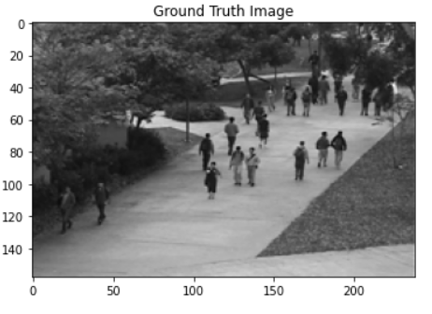
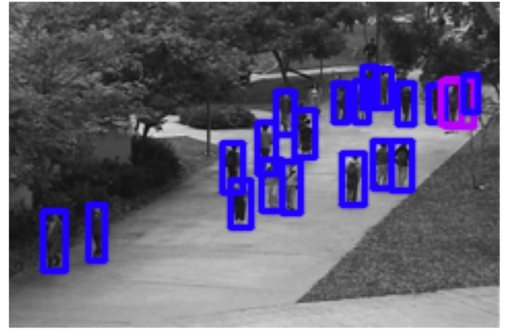
Results - RetinaNet
UCSD_Dataset

Slide 20
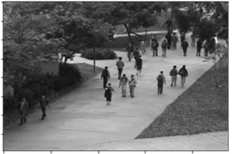
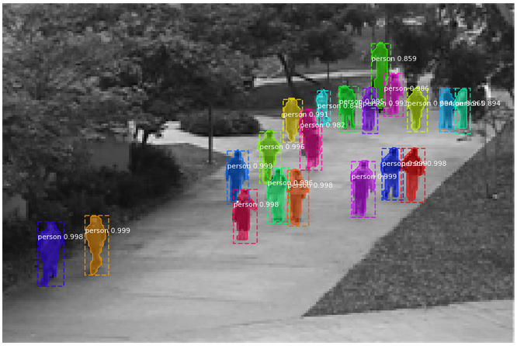
Results - Mask RCNN
On UCSD Dataset
Ground Truth | Detected
Notes:
Mask RCNN ON UCSD DATASET
RCNN Dataset
Abnormal Crowd Behavior Detection AutoEnccoder UCSD Dataset

Slide 21
Yolo
You Only Look Once
Introduction:
YOLO - is an algorithm proposed by by Redmond et. al in a research article published at the IEEE/CVF Conference on Computer Vision and Pattern Recognition (CVPR) as a conference paper, winning OpenCV People’s Choice Award.
Compared to the approach taken by object detection algorithms before YOLO, which repurpose classifiers to perform detection,
YOLO proposes the use of an end-to-end neural network that makes predictions of bounding boxes and class probabilities all at once.
Inspired by the GoogleNet architecture, YOLO’s architecture has a total of 24 convolutional layers with 2 fully connected layers at the end.

Slide 22
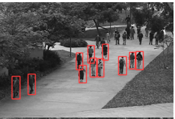
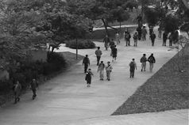
Results YoloV5
Can’t detect faraway and small objects in most of test frames

Slide 23
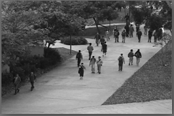
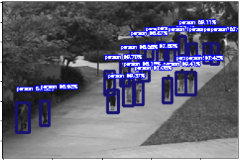
Results YoloV3

Slide 24
Multiple Instance Learning with C3D Model

Slide 25
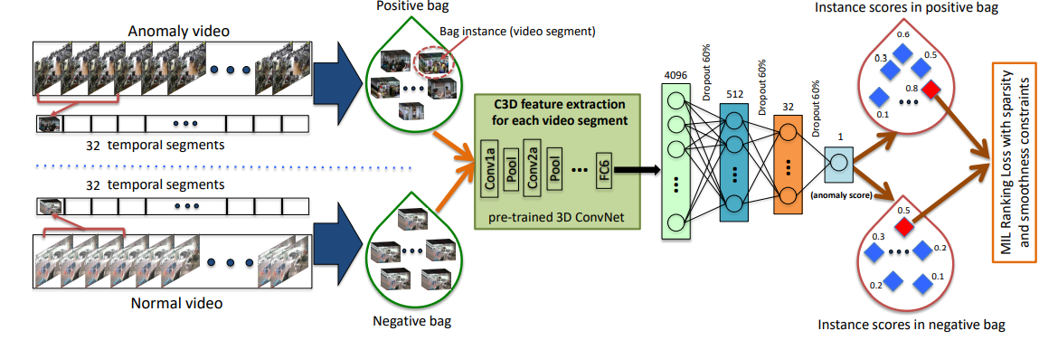
Methodology & Architecture
Multiple Instance Learning with C3D Model
Paper:Real-world Anomaly Detection in Surveillance Videos
Notes:
The flow diagram of the proposed anomaly detection approach. Given the positive (containing anomaly somewhere) and negative (containing no anomaly) videos, we divide each of them into multiple temporal video segments. Then, each video is represented as a bag and each temporal segment represents an instance in the bag. After extracting C3D features for video segments, we train a fully connected neural network by utilizing a novel ranking loss function which computes the ranking loss between the highest scored instances (shown in red) in the positive bag and the negative bag

Slide 26
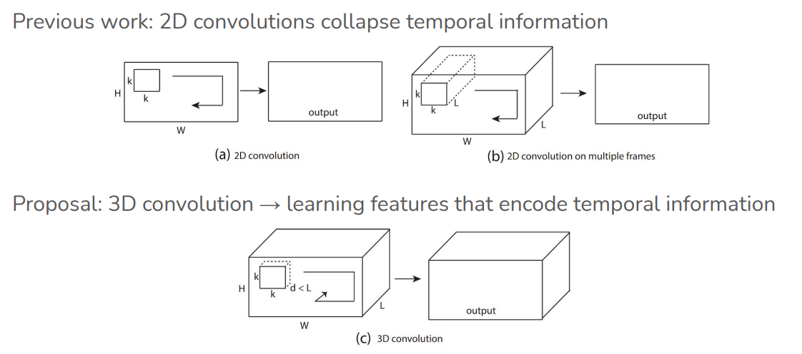
Multiple Instance Learning with C3D Model
Feature Extraction - C3D Model
Extend 2D Convs and pooling to 3D to slowly fuse temporal information throughout the model
Slide the kernels in both space and time (Temporal shift-invariant!)
Notes:
Videos Videos are all around us Span an enormous space of spatial and temporal signals,
Challenges in Videos ● Computationally expensive ○ Size of video >> image datasets ● Lower quality ○ Resolution, motion blur, occlusion ● Additional Variance ○ Possibilities in videos >> Images ● Requires lots of training data!,
What a video framework should have,
Sequence modeling ● Temporal reasoning (receptive field) ● Focus on action recognition ○ Representative task for video understanding,

Slide 27
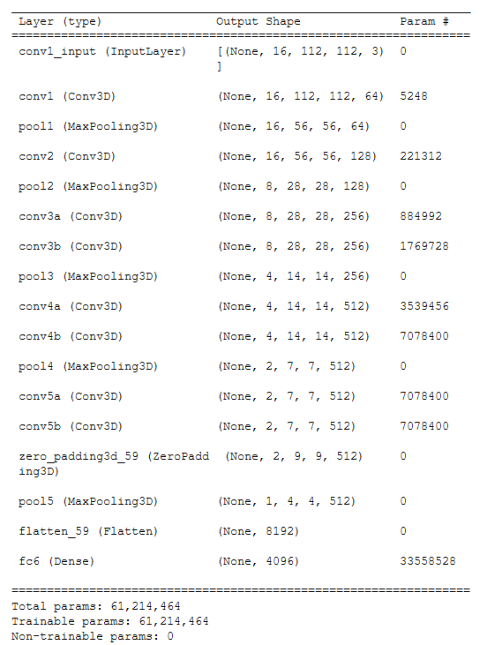
Multiple Instance Learning with C3D Model
Feature Extraction - C3D Model (Pretrained - Model)
C3D video descriptor was used as the feature extractor of their method, after computing C3D features for every 16-frame video clip to all the dataset and extracting the fully connected layer FC6 from the C3D network.
This approach obtains one video segment’s feature by splitting the video into 32 segments and taking the average of all 16-frame clip features contained in each segment. Thus a bag contains 32 instances.

Slide 28
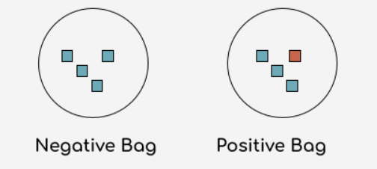
Multiple Instance Learning with C3D Model
2) Multiple Instance Learning
Multiple Instance Learning (MIL) is a form of weakly supervised learning where training instances are arranged in sets, called bags, and a label is provided for the entire bag, opposedly to the instances themselves. This allows to leverage weakly labeled data.
Negative bags are said to contain only
negative instances
Positive bags contain at least one positive instance

Slide 29
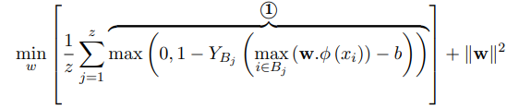
Multiple Instance Learning with C3D Model
2) Multiple Instance Learning
As the exact information of the positive instances is not known, the implemented ranking function can be optimized concerning the maximum scored instance in each bag, as followed:
where ⃝ 1 is the hinge loss (for maximum-margin classification), YBj is the bag-level label, z is the total number of bags, ϕ (xi) denotes feature representation of the video segment i, b is a bias and w is the classifier to be learned (model weights).
Notes:
propose to learn anomaly through a deep Multiple Instance Learning (MIL) framework, a type of supervised learning that receives a set of individually labeled instances, and all the instances with the same label are grouped, as bags. By exploiting both normal and abnormal videos, each video is divided into non-overlapping temporal segments, where different segments make individual instances in a bag. Thus, a video is labeled as a positive bag if at least one of the instances contains an anomaly, and a video without any abnormal instance is labeled as a negative bag.
MIL relaxes the assumption of having these accurate temporal annotations. In MIL, precise temporal locations of anomalous events in videos are unknown. Instead, only video-level labels indicating the presence of an anomaly in the whole video is needed. A video containing anomalies is labeled as positive and a video without any anomaly is labeled as negative. Then, we represent a positive video as a positive bag Ba, where different temporal segments make individual instances in the bag, (p 1 , p2 , . . . , pm), where m is the number of instances in the bag. We assume that at least one of these instances contains the anomaly. Similarly, the negative video is denoted by a negative bag, Bn, where temporal segments in this bag form negative instances (n 1 , n2 , . . . , nm). In the negative bag, none of the instances contain an anomaly.

Slide 30
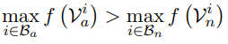
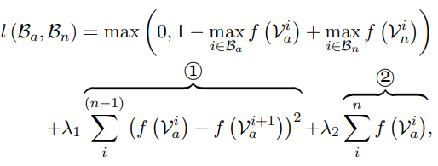
Multiple Instance Learning with C3D Model
Deep MIL Ranking Model
In this approach,the goal is to have high scores for abnormal videos and low scores for normal videos. as the annotation is video-level, a multiple instance ranking objective function, used as loss function, based on ranking only the two instances having the highest anomaly score respectively in the positive and negative bag:
where max take over all video segments in each bag,
f(Va) and f(Vn) represents the prediction score of the abnormal and normal video segments i, respectively. One limitation of the above loss is that it ignores the underlying temporal structure of the anomalous video,to overcome this issue By incorporating the sparsity and smoothness constraints on the instance scores, the loss function becomes:
Notes:
As a result of the highest anomaly score in the positive bag, the probability of being the true positive instance is very high. On the other hand, the highest score in the negative bag may look like an anomalous segment but is still a normal segment, which may generate a false positive. The purpose of the multiple instance ranking objective function is to penalize both negative instances with high scores and positive instances with low scores.
Instead of enforcing ranking on every instance of the bag, we enforce ranking only on the two instances having the highest anomaly score respectively in the positive and negative bags. The segment corresponding to the highest anomaly score in the positive bag is most likely to be the true positive
instance (anomalous segment). The segment corresponding to the highest anomaly score in the negative bag is the one looks most similar to an anomalous segment but actually is a normal instance. This negative instance is considered as a hard instance which may generate a false alarm in anomaly detection. By using Eq., we want to push the positive instances and negative instances far apart in terms of anomaly score
One limitation of the above loss is that it ignores the underlying temporal structure of the anomalous video. First, in real-world scenarios, anomaly often occurs only for a short time. In this case, the scores of the instances (segments) in the anomalous bag should be sparse, indicating only a few segments may contain the anomaly. Second, since the video is a sequence of segments, the anomaly score should vary smoothly between video segments. Therefore, we enforce temporal smoothness between anomaly scores of temporally adjacent video segments by minimizing the difference of scores for adjacent video segments. By incorporating the sparsity and smoothness constraints on the instance scores, the loss function becomes

Slide 31
Multiple Instance Learning with C3D Model
Preprocessing & Implementation Details
1) re-size each video frame to 240 × 320 pixels and fix the frame rate to 30 fps.
2) compute C3D features for every 16-frame video clip followed by L2 normalization.
3)To obtain features for a video segment, we take the average of all 16-frame clip features within that segment. We input these features (4096D) to a 4-layer FC neural network.
4)Divide each video into 32 non-overlapping segments and consider each video segment as an instance of the bag. The number of segments (32) is empirically set.
5)Randomly select 30 positive and 30 negative bags as a mini-batch and compute gradients.
Notes:
The first FC layer has 512 units followed by 32 units and 1 unit FC layers. 60% dropout regularization [33] is used between FC layers. We experiment with deeper networks but do not observe better detection accuracy. We use ReLU [19] activation and Sigmoid activation for the first and the last FC layers respectively, and employ Adagrad [14] optimizer with the initial learning rate of 0.001. The parameters of sparsity and smoothness constraints in the MIL ranking loss are set to λ1=λ2 = 8 × 10−5 for the best performance.

Slide 32
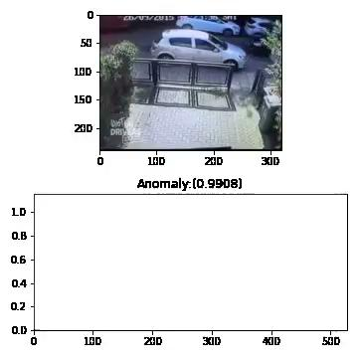
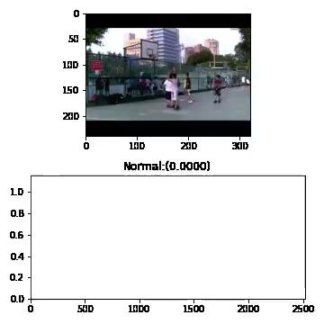
Output Example: Prediction score per clip

Slide 33
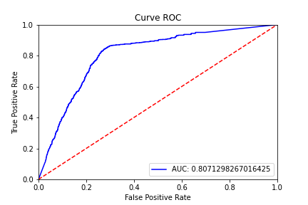
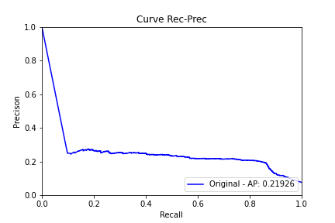
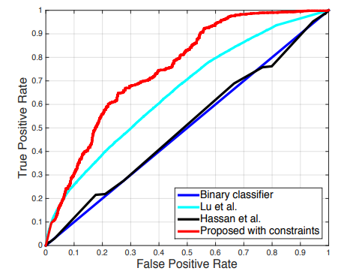
Multiple Instance Learning with C3D Model
Conclusion & Results:
Evaluation Metric: we used frame based receiver operating characteristic (ROC) curve and corresponding area under the curve (AUC) to evaluate the performance of the model: Achieving higher results than the original paper.
Metric | Value
Acc | 0.82
F1 | 0.32
Modified Model results (ROC , AUC & Average Precision)
Original Paper ROC with AUC of 0.75

Slide 34
Autoencoder & Generative Adversarial Networks(GANs)

Slide 35
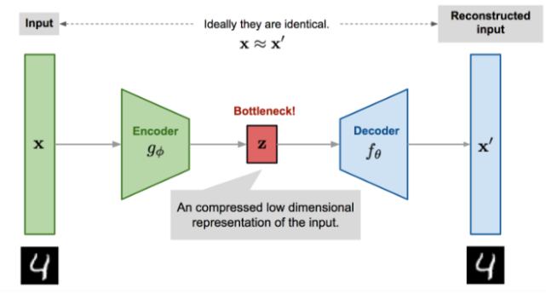
Auto Encoder
AutoEncoder is a generative unsupervised deep learning algorithm used for reconstructing high-dimensional input data using a neural network with a narrow bottleneck layer in the middle which contains the latent representation of the input data.

Slide 36
Autoencoder consists of an Encoder and a Decoder.
Encoder network: Accepts high-dimensional input data and translates it to latent low-dimensional data. The input size to an Encoder network is larger than its output size.
Decoder network: The Decoder network receives the input from the Encoder coder’s output. Decoder’s objective is to reconstruct the input data. The output size of a Decoder network is larger than its input size.

Slide 37
AutoEncoders Usage
Dimensionality Reduction The Encoder encodes the input into the hidden layer to reduce the dimensionality of linear and nonlinear data; hence it is more powerful than PCA.
Anomaly Detection: Autoencoders tries to minimize the reconstruction error as part of its training. Anomalies are detected by checking the magnitude of the reconstruction loss.
Denoising Images: An image that is corrupted can be restored to its original version.
Image recognition: Stacked autoencoder are used for image recognition by learning the different features of an image.
Image generation: Variational Autoencoder(VAE), a type of autoencoders, is used to generate images.

Slide 38
Early age of image anomaly detection
An early application of autoencoders to anomaly detection was performed in on non-visual data, constitutes of a feed-forward multi-layer. perceptron with three hidden layers, trained to map the training dataset to itself and anomalies correspond to large reconstruction error over test datasets.
This is an autoencoder setup with a staircase like non-linearity applied at the middle hidden layer.
A rejection cascade over spatio-temporal cubes was gener-ated to improve the performance speed of Deep-CNN based video anomaly detection framework, Videos can be viewed as a special case of spatio-temporal processes.
A direct approach to video anomaly detection can be estimating the spatio-temporal mean and covariance. A major issue is estimating the spatio-temporal covariance matrix due to its large size n2 (where n = N pixels × p frames). space-time pixel covariance.

Slide 39
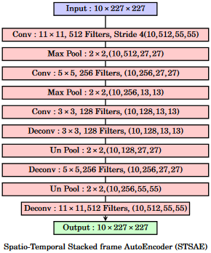
Spatio temporal stacked frame AutoEncoder
Notes:
Spatio-Temporal Stacked frame AutoEncoder: A sequence of 10 frames are being reconstructed by a convolutional autoencoder, image reproduced from

Slide 40
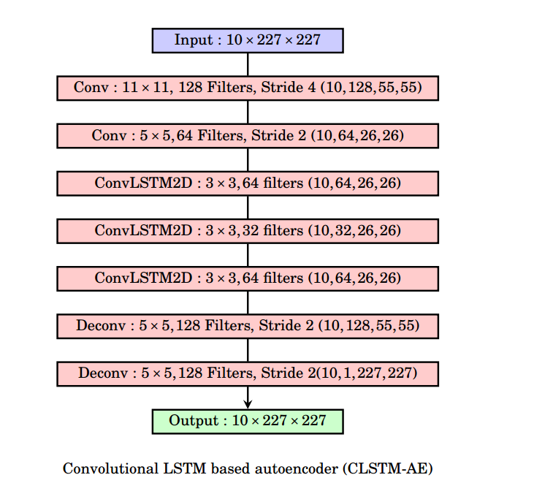
Convolutional LSTM based autoencoder
Notes:
Convolutional LSTM based autoencoder : A sequence of 10 frames are being reconstructed by a spatio-temporal autoencoder with image size 227x227, The Convolutional LSTM layers are predictive models that model the spatio-temporal correlation of pixels in the video. This is described in the predictive model section

Slide 41
Convolutional LSTM based autoencoder
Model aim to model the current output frame Xt as a function of the past p frames [Xt−1, Xt−2, ..., Xt].
Thisis well-known in time series analysis under auto-regressive models, where the function over the past is linear. Recurrent neural networks (RNN) model this function as a recurrence relationship, frequently involving a non-linearity such as a sigmoid function.
LSTM is the standard model for sequence prediction, It learns a gating function over the classical RNN architecture to prevent the vanishing gradient problem during backpropagation through time (BPTT).
Recently there have also been attempts to perform efficient video prediction using feed-forward convolutional networks for video prediction by minimizing the mean squared error (MSE) between predicted

Slide 42
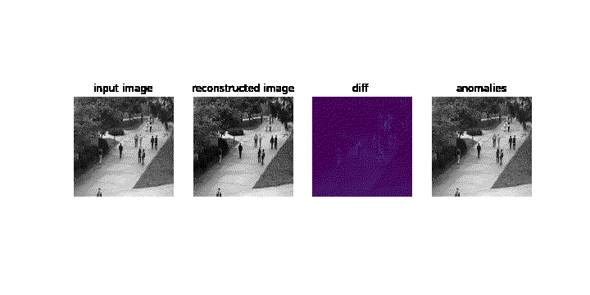
Results

Slide 43
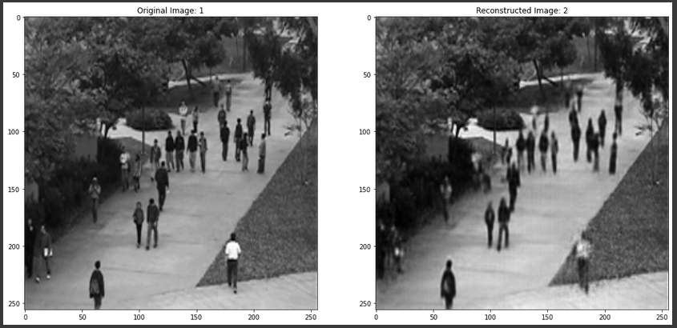
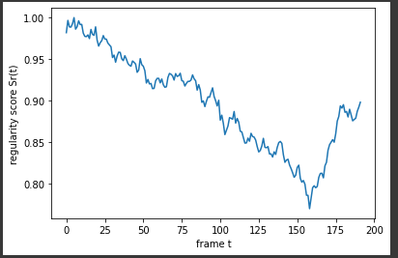
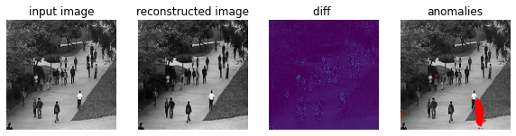

Slide 44
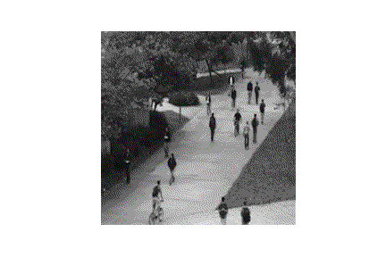
Detection Issues
Overfit on the bicycle rider in some videos and skateboard
False negative for some persons
there are some skipping anomaly frames
low accuracy over all frames for this example was 11.4
not all ground truth are correct

Slide 45
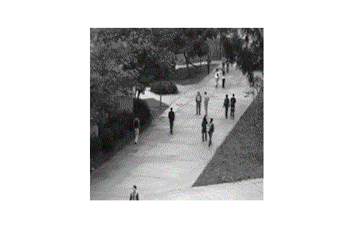
Localization

Slide 46
Generative Adversarial Networks(GANs)
Generative modeling is an unsupervised learning task in machine learning that involves automatically discovering and learning the regularities or patterns in input data in such a way that the model can be used to generate or output new examples that plausibly could have been drawn from the original dataset.
System of two neural networks competing against each other in a zero-sum game framework.
Can learn to draw samples from a model that is similar to data that we give them.

Slide 47
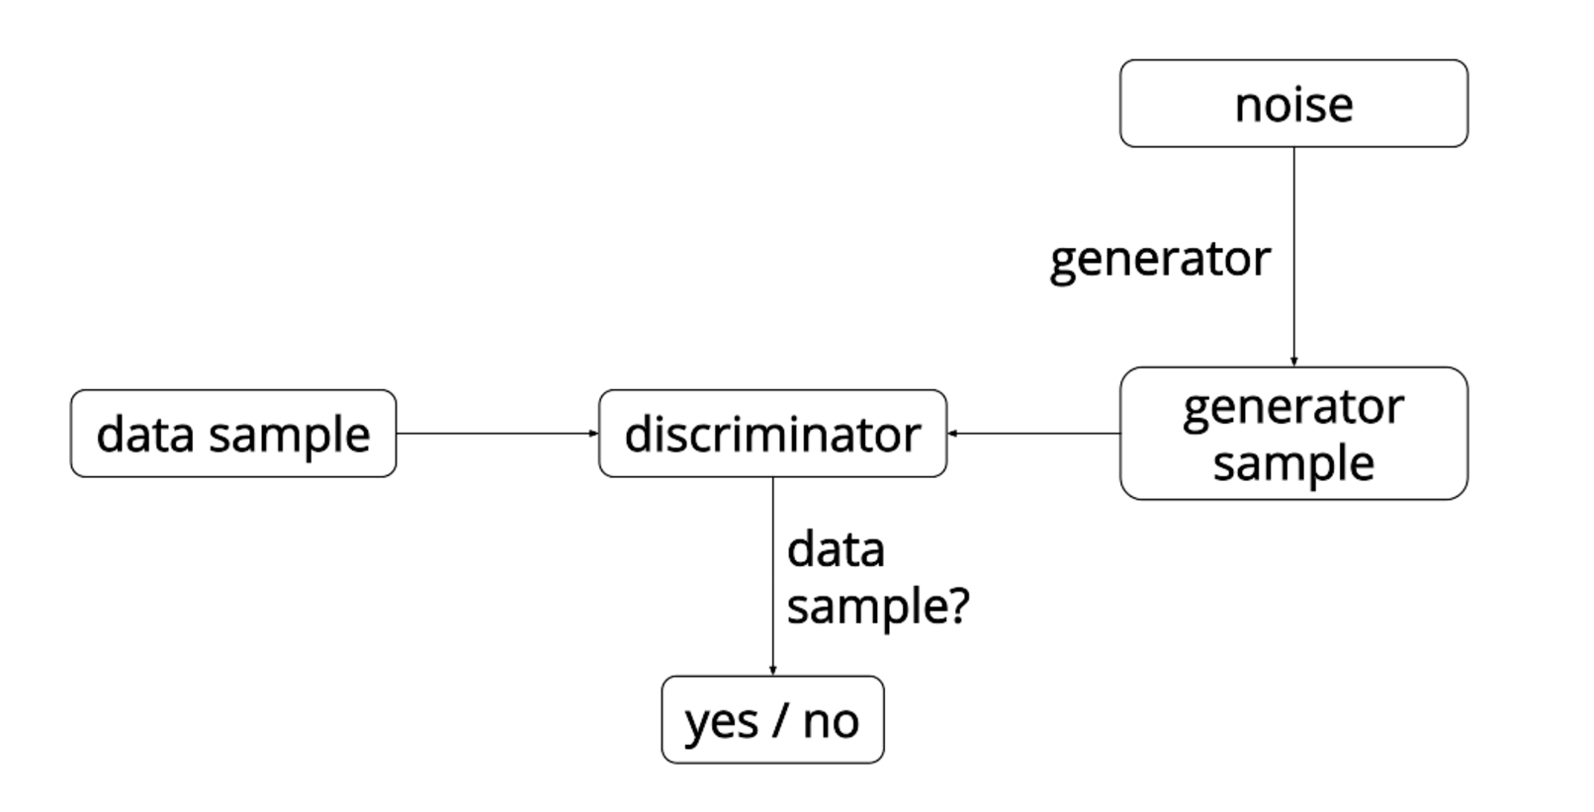
GANs
GANs are a clever way of training a generative model by framing the problem as a supervised learning problem with two sub-models: the generator model that we train to generate new examples, and the discriminator model that tries to classify examples as either real (from the domain) or fake (generated). The two models are trained together in a zero-sum game, adversarial, until the discriminator model is fooled about half the time, meaning the generator model is generating plausible examples.

Slide 48
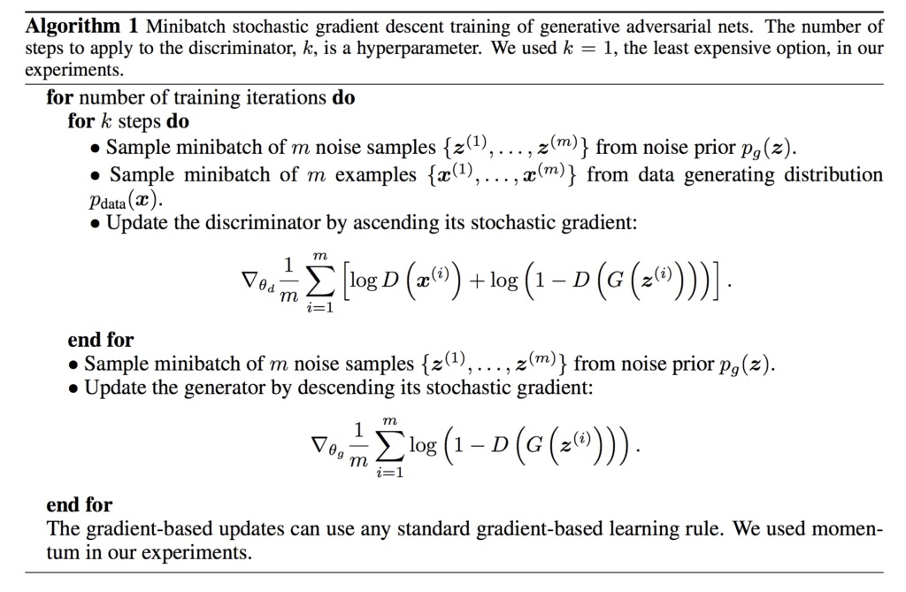
Notes:
Objective of generative network - increase the error rate of the discriminative network.
Objective of discriminative network – decrease binary classification loss.

Slide 49
Conditional Generative Adversarial Networks (CGAN)
In cGANs, a conditional setting is applied, meaning that both the generator and discriminator are conditioned on some sort of auxiliary information (such as class labels or data) from other modalities. As a result, the ideal model can learn multi-modal mapping from inputs to outputs by being fed with different contextual information.
cGANs are not strictly unsupervised learning algorithms because they require labeled data as input to the additional layer.

Slide 50
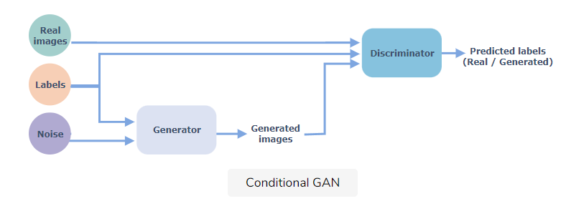
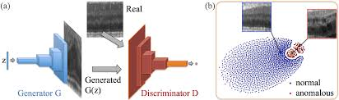
Conditional Generative Adversarial Networks (CGAN)
We will use a conditional GAN with AutoEncoder to identify the anomaly .

Slide 51
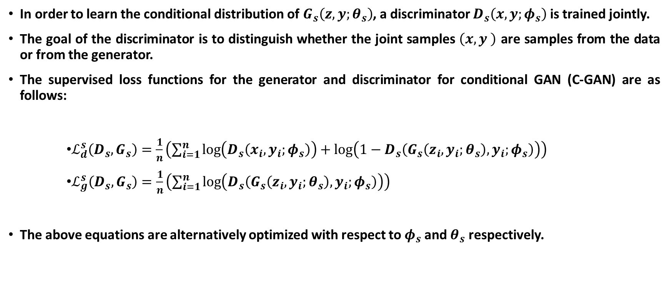
Conditional Generative Adversarial Networks (CGAN)

Slide 52
Classifier
From the encoding part of the autoencoder we can use the bottleneck as a feature vector for this frame events, and taking the majority of the labels to be the classification output for this video
Combining the encoder layers and disable the training part of it, with adding more layers and softmax for the events will enable us to classify the video.
But as we can see this classifier depend on it representer (Encoder) so, we need to make sure first the Autoencoder reached to lowest loss as possible, to have a good accuracy.

Slide 53
BUT..
Time and performance was the problem
like
Running the models with 256x256x3 frame size and sequence 16 frame on tesla GPU for one epoch give us 17h for just one epoch.
Feeding the model with just one video still consume +13 GB memory and the Running keep stopping.
Some videos was so big like 1GB and converting it to npz with overlapping need space above 19GB hard disk.
And if we follow the idea of converting on the run this will consume more time.
And gan it self need more times epoch to train

Slide 54
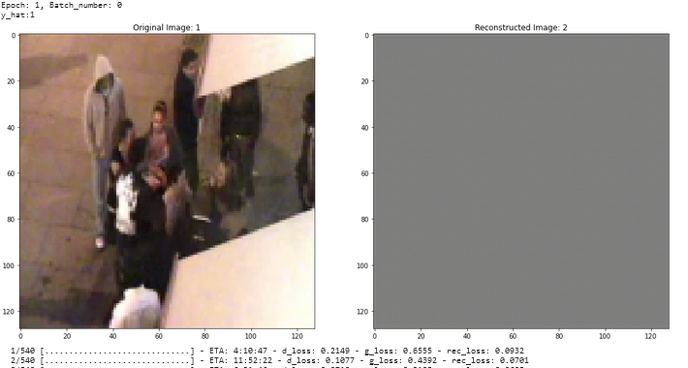
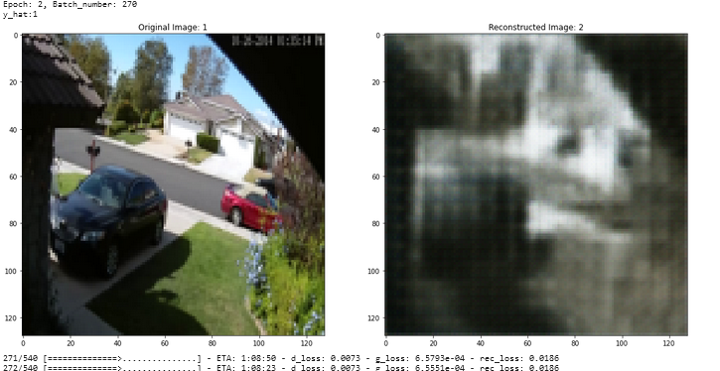
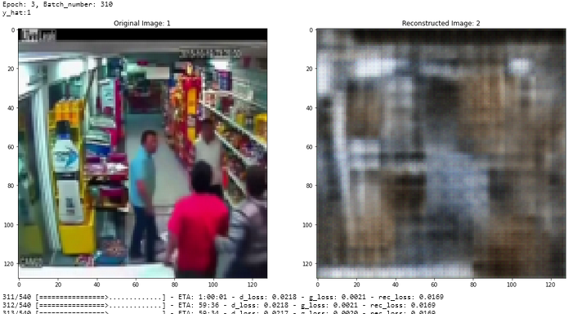

Slide 55
BUT… We never give up
using SlowFast from Facebook AI Research
SlowFast networks can be described as a single stream architecture that operates at two different framerates a Slow pathway and a Fast pathway.
The use of two parallel convolution neural networks (CNNs) on the same video segment
The authors observe that frames in video scenes usually contain two distinct parts — static areas in the frame which don’t change at all or change slowly, and dynamic areas which indicate something important that is currently going on.

Slide 56
SlowFast
Uses a slow, high-definition CNN (Fast pathway) to analyze the static content of a video while running in parallel a fast, low-definition CNN (Slow pathway) whose goal is to analyze the dynamic content of a video.
The technique is partially inspired by the retinal ganglion in primates, in which 80% of the cells (P-cells) operate at low temporal frequency and recognize fine details, and ~20% of the cells (M-cells) operate at high temporal frequency and are responsive to swift changes. Similarly, in SlowFast the compute cost of the Slow pathway is 4x larger than that of the Fast pathway

Slide 57
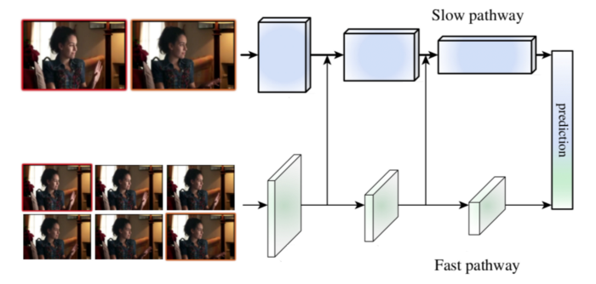
SlowFast

Slide 58
SlowFast
Both the Slow and Fast pathways use a 3D ResNet model, capturing several frames at once and running 3D convolution operations on them.
The Slow pathway uses a large temporal stride (i.e. number of frames skipped per second) τ, typically set at 16, allowing for approximately 2 sampled frames per second.
The Fast pathway uses a much smaller temporal stride τ/α, with α typically set at 8, allowing for 15 frames per second.
The Fast pathway is kept lightweight by using a significantly smaller channel size (i.e. convolution width; number of filters used), typically set at ⅛ of the Slow channel size.
The channel size of the Fast pathway is marked as β.
The consequence of the smaller channel size is that the Fast pathway requires 4x less compute than the Slow pathway despite having a higher temporal frequency.

Slide 59
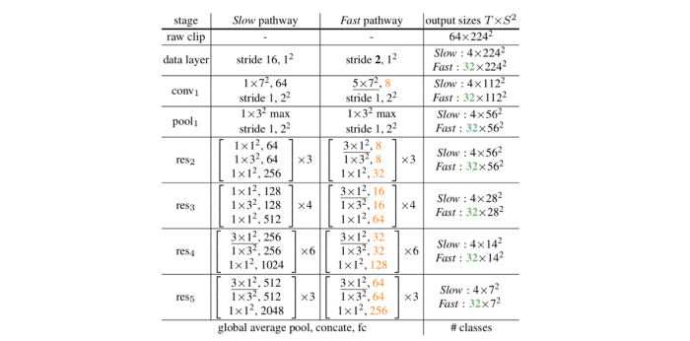
Notes:
An example instantiation of the SlowFast network. The dimensions of kernels are denoted by {T×S², C} for temporal (T), spatial (S), and channel © sizes. Strides are denoted as {temporal stride, spatial stride ^ 2}. The speed ratio (frame skipping rate) is α = 8 and the channel ratio is 1/β = 1/8. τ is 16. The green colors mark higher temporal resolution, and orange colors mark fewer channels, for the Fast pathway. The lower temporal resolution of the Fast pathway can be observed in the data layer row while the smaller channel size can be observed in the conv1 row and afterward in the residual stages. Residual blocks are shown by brackets. The backbone is ResNet-50. (Image & Description from SlowFast)

Slide 60
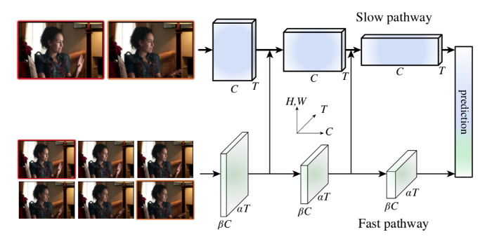
Lateral Connections

Slide 61
Lateral Connections
As shown in the visual illustration, data from the Fast pathway is fed into the Slow pathway via lateral connections throughout the network, allowing the Slow pathway to become aware of the results from the Fast pathway. The shape of a single data sample is different between the two pathways (Fast is {αT, S², βC} while Slow is {T, S², αβC}), requiring SlowFast to perform data transformation on the results of the Fast pathway, which is then fused into the Slow pathway by summation or concatenation.

Slide 62
Lateral Connections data transformation
There arethree techniques for data transformation, with the third one proving in practice to be the most effective:
Time-to-channel: Reshaping and transposing {αT, S², βC} into {T , S², αβC}, meaning packing all α frames into the channels of one frame.
Time-strided sampling: Simply sampling one out of every α frames, so {αT , S², βC} becomes {T , S², βC}.
Time-strided convolution: Performing a 3D convolution of a 5×12 kernel with 2βC output channels and stride = α.
the researchers found that bidirectional lateral connections, i.e. also feeding the Slow pathway into the Fast pathway, do not improve performance

Slide 63
Combining the pathways
.At the end of each pathway, SlowFast performs Global Average Pooling, a standard operation intended to reduce dimensionality. It then concatenates the results of the two pathways and inserts the concatenated result into a fully connected classification layer which uses Softmax to classify which action is taking place in the image.

Slide 64
Slowfast On Abnormal Events
By applying the Slowfast model on our dataset with this configrations
just 10 images from each sample video
frame size 128x128x3
only on 4 categories
splitting our 2000 sample to 0.9 train and 0.1 for test
we reached to:
98% accuracy on training
50% accuracy on testing

Slide 65
Appendix

Slide 66
RETINANET
Focal Loss for Dense Object Detection
Introduction:
RetinaNet was introduced by Facebook AI Research to tackle the dense detection problem. It was needed to fill in for the imbalances and inconsistencies of the single-shot object detectors like YOLO and SSD while dealing with extreme foreground-background classes.
RetinaNet has been formed by making two improvements over existing single stage object detection models - Feature Pyramid Networks (FPN) [1] and Focal Loss [2].
Before diving into RetinaNet’s architecture, let's first understand FPN & Focal Loss.

Slide 67
RETINANET
Focal Loss for Dense Object Detection
Feature Pyramid Network
Traditionally, in computer vision, feature image pyramids have been used to detect objects with varying scales in an image. Feature image pyramids are feature pyramids built upon image pyramids. This means one would take an image and subsample it into lower resolution and smaller size images (thus, forming a pyramid). Hand-engineered features are then extracted from each layer in the pyramid to detect the objects . This makes the pyramid scale-invariant. But, this process is compute and memory intensive.
With the advent of deep learning, these hand-engineered features were replaced by CNNs. Later, the pyramid itself was derived from the inherent pyramidal hierarchical structure of the CNNs. In a CNN architecture, the output size of feature maps decreases after each successive block of convolutional operations, and forms a pyramidal structure.

Slide 68
RETINANET
Focal Loss for Dense Object Detection
RetinaNet architecture
RetinaNet = ResNet+ FPN + Focal Loss
There are four major components of a RetinaNet model architecture :
a) Bottom-up Pathway - The backbone network (e.g. ResNet) which calculates the feature maps at different scales, irrespective of the input image size or the backbone. b) Top-down pathway and Lateral connections - The top down pathway up samples the spatially coarser feature maps from higher pyramid levels, and the lateral connections merge the top-down layers and the bottom-up layers with the same spatial size. c) Classification subnetwork - It predicts the probability of an object being present at each spatial location for each anchor box and object class. d) Regression subnetwork - It's regresses the offset for the bounding boxes from the anchor boxes for each ground-truth object.

Slide 69
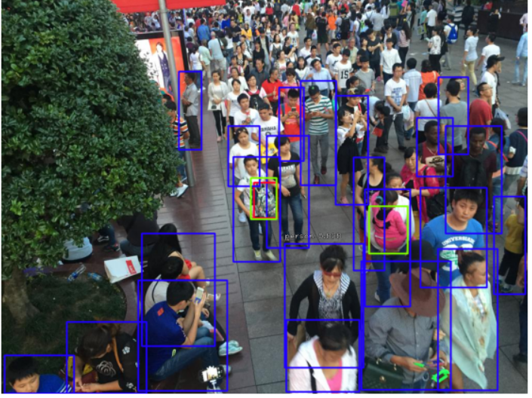

IMPLEMENTATION
retinanet_trial | Kaggle
Dense Crowd Datasets : UCF , Shanghai

Slide 70
Mask RCNN
Mask RCNN
Introduction to Faster RCNN
Mask R-CNN modules
Backbone
Feature Pyramid Network
Region Proposal Network (RPN)
ROI Classifier & Bounding Box Regressor
Segmentation Masks
R-CNN Comparison
Mask R-CNN Performance

Slide 71

Mask RCNN
Mask R-CNN (regional convolutional neural network) is a two stage framework: the first stage scans the image and generates proposals(areas likely to contain an object). And the second stage classifies the proposals and generates bounding boxes and masks.
It was introduced last year via the Mask R-CNN paper to extend its predecessor, Faster R-CNN.

Slide 72

Faster-RCNN
Instead of using selective search algorithm on the feature map to identify the region proposals, a separate network is used to predict the region proposals. The predicted region proposals are then reshaped using a RoI pooling layer which is then used to classify the image within the proposed region and predict the offset values for the bounding boxes.
Notes:
Both of the above algorithms(R-CNN & Fast R-CNN) uses selective search to find out the region proposals.
Selective search is a slow and time-consuming process affecting the performance of the network, came up with an object detection algorithm that eliminates the selective search algorithm and lets the network learn the region proposals.
Similar to Fast R-CNN, the image is provided as an input to a convolutional network which provides a convolutional feature map.

Slide 73

Backbone
This is a standard convolutional neural network (typically, ResNet50 or ResNet101) that serves as a feature extractor. The early layers detect low level features (edges and corners), and later layers successively detect higher level features (car, person, sky).
Passing through the backbone network,
the image is converted from
1024x1024px x 3 (RGB)
to a feature map of shape 32x32x2048.
This feature map becomes the input for the
following stages.

Slide 74

Feature Pyramid Network
While the backbone described above works great, it can be improved upon, The Feature Pyramid Network (FPN) was introduced as an extension that can better represent objects at multiple scales.
FPN improves the standard feature extraction pyramid by adding a second pyramid that takes the high level features from
the first pyramid and passes them down to lower layers.
By doing so, it allows features at every level to have access to both, lower and higher level features.

Slide 75

Region Proposal Network (RPN)
The RPN is a lightweight neural network that scans the image in a sliding-window fashion and finds areas that contain objects.
The regions that the RPN scans over are called anchors. Which are boxes distributed over the image area, as show on the left. This is a simplified view, though. In practice, there are about 200K anchors of different sizes and aspect ratios, and they overlap to cover as much of the image as possible.
This allows the RPN to reuse the extracted features efficiently and avoid duplicate calculations. With these optimizations, the RPN runs in about 10 ms according to the Faster RCNN paper that introduced it.
Notes:
How fast can the RPN scan that many anchors? Pretty fast, actually. The sliding window is handled by the convolutional nature of the RPN, which allows it to scan all regions in parallel (on a GPU).
Further, the RPN doesn’t scan over the image directly (even though we draw the anchors on the image for illustration). Instead, the RPN scans over the backbone feature map.
Anchor Class: One of two classes: foreground or background, The FG class implies that there is likely an object in that box.
Bounding Box Refinement: A foreground anchor (also called positive anchor) might not be cantered perfectly over the object.
Using the RPN predictions, we pick the top anchors that are likely to contain objects and refine their location and size.
If several anchors overlap too much, we keep the one with the highest foreground score and discard the rest (referred to as Non-max Suppression). After that we have the final proposals (regions of interest) that we pass to the next stage.
In Mask RCNN we typically use larger images and more anchors, so it might take a bit longer.

Slide 76

ROI Classifier & Bounding Box Regressor
This stage runs on the regions of interest (ROIs) proposed by the RPN. And just like the RPN, it generates two outputs for each ROI:
Notes:
Class: The class of the object in the ROI. Unlike the RPN, which has two classes (FG/BG), this network is deeper and has the capacity to classify regions to specific classes (person, car, chair, …etc.). It can also generate a background class, which causes the ROI to be discarded.
Bounding Box Refinement: Very similar to how it’s done in the RPN, and its purpose is to further refine the location and size of the bounding box to encapsulate the object.

Slide 77

ROI Pooling
Classifiers don’t handle variable input size very well. They typically require a fixed input size. But, due to the bounding box refinement step in the RPN, the ROI boxes can have different sizes. That’s where ROI Pooling comes into play.
Notes:
ROI pooling refers to cropping a part of a feature map and resizing it to a fixed size. It’s similar in principle to cropping part of an image and then resizing, ROIAlign, sample the feature map at different points and apply a bilinear interpolation.

Slide 78

Faster RCNN

Slide 79

Segmentation Masks
If you stop at the end of the last section then you have a Faster R-CNN framework for object detection. The mask network is the addition that the Mask R-CNN paper introduced.
Notes:
uThe mask branch is a convolutional network that takes the positive regions selected by the ROI classifier and generates masks for them. The generated masks are low resolution: 28x28 pixels. But they are soft masks, represented by float numbers, so they hold more details than binary masks. The small mask size helps keep the mask branch light. During training, we scale down the ground-truth masks to 28x28 to compute the loss, and during inferencing we scale up the predicted masks to the size of the ROI bounding box and that gives us the final masks, one per object.
uThe mask branch is a convolutional network that takes the positive regions selected by the ROI classifier and generates masks for them. The generated masks are low resolution: 28x28 pixels. But they are soft masks, represented by float numbers, so they hold more details than binary masks. The small mask size helps keep the mask branch light. During training, we scale down the ground-truth masks to 28x28 to compute the loss, and during inferencing we scale up the predicted masks to the size of the ROI bounding box and that gives us the final masks, one per object.

Slide 80

Mask R-CNN modules

Slide 81

R-CNN Comparison
There are four types of R-CNN. Each type attempts to optimize, speed up, or enhance object detection results. Let’s compare these algorithms:

Slide 82

Mask R-CNN Performance
Precision and recall of pre-trained and trained Yolo v2 and Mask RCNN models for ball detection on the full dataset
Notes:
Results of precision and recall for ball detection models shown in Fig. 5. and Fig. 6. indicate higher recall values and lower precision when models are additionally trained on ball objects. Results in Fig. 6. indicate significantly higher recall values, up to 40%, on the custom dataset when Yolo v2 was used, but at the expense of dropping precision. On the same dataset, the recallincreased only by 8% in the case of the Mask model, while precision decreased significantl

Slide 83


IMPLEMENTATION
On UCF-QNRF Dataset
Ground Truth | Detected
Notes:
Mask RCNN ON UCSD DATASET
RCNN Dataset
Abnormal Crowd Behavior Detection AutoEnccoder UCSD Dataset

Slide 84
Yolo Vs other detectors
YOLO is a much faster algorithm than its counterparts, running at as high as 45 FPS.
Methods that use Region Proposal Networks thus end up performing multiple iterations for the same image, while YOLO gets away with a single iteration.
Limitations:
YOLO struggles to detect and segregate small objects in images that appear in groups
Since the model learns to predict bounding boxes from data, it struggles to generalize to objects in new or unusual aspect ratios or configurations.

Slide 85

YOLOV5 - IMPLEMENTATION
Dense crowd : UCF - Shanghai

Slide 86
References
➤ An Efficient Anomaly Recognition Framework Using an Attention Residual LSTM in Surveillance Videos ***
➤ Density-aware person detection and tracking in crowds
➤ Object-centric Auto-encoders and Dummy Anomalies for Abnormal Event Detection in Video
➤ Abnormal Crowd Behavior Detection using Social Force Model
➤ Group Abnormal Behaviour Detection Algorithm Based on Global Optical Flow
➤ Optical Flow Approach Followed by SVM Classification Model to Recognize Abnormal Behavior of a Crowd
➤ ABNORMAL EVENT DETECTION IN VIDEOS USING GENERATIVE ADVERSARIAL NETS
➤ Abnormal Event Detection in Videos using Spatiotemporal Autoencoder ***
➤ An overview of deep learning based methods for unsupervised and semi-supervised anomaly detection in videos ***
➤ Real-world Anomaly Detection in Surveillance Videos***
➤ Object Detection and Localization using Deep Convolutional Networks with Softmax Activation and Multi-class Log Loss
➤Analyzing Tracklets for the Detection of Abnormal Crowd Behavior
➤Abnormal Crowd Motion Analysis

Slide 87
References cont.
➤ Abnormal Crowd Behavior Detection Using Motion Information Images and Convolutional Neural Networks
➤ Abnormal Crowd Behavior Detection Using Heuristic Search and Motion Awareness
➤ Congested Crowd Instance Localization with Dilated Convolutional Swin Transformer
➤ Encoder-Decoder Based Convolutional Neural Networks with Multi-Scale-Aware Modules for Crowd Counting
➤ CSRNet: Dilated Convolutional Neural Networks for Understanding the Highly Congested Scenes
➤ Revisiting crowd behaviour analysis through deep learning: Taxonomy, anomaly detection***
➤ Advances and Trends in Real Time Visual Crowd Analysis
➤ Weakly and Partially Supervised Learning Frameworks for Anomaly Detection
➤Anomaly Detection in Video Sequence with Appearance-Motion Correspondence

